Slide 1
Looking for Patterns on Realself Reviews

Slide 2
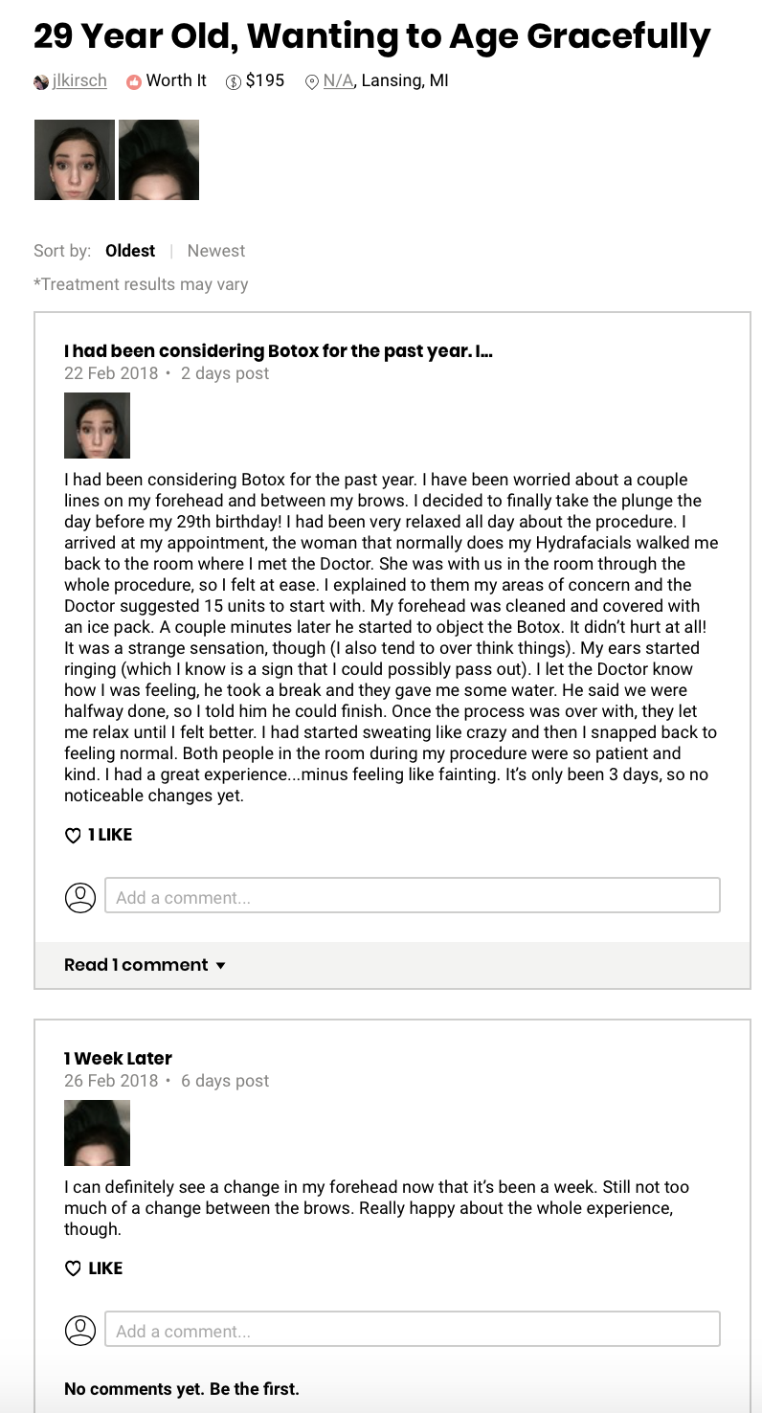
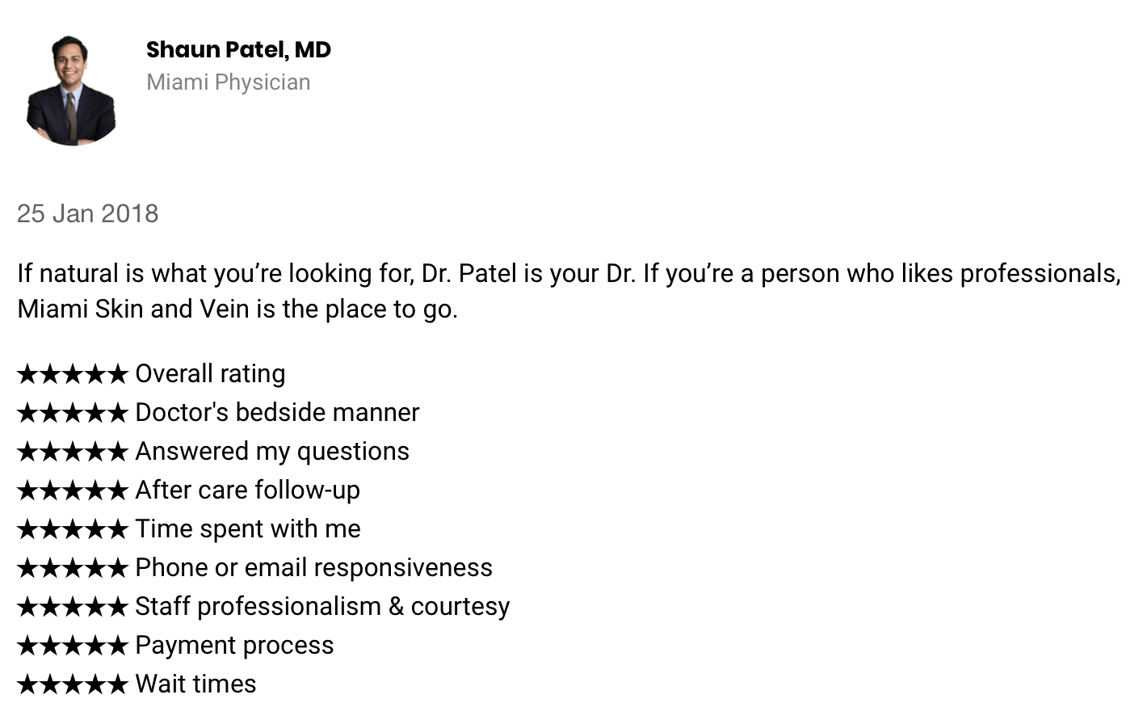
Motivation: find hidden topics on treatment’s reviews
Treatment’s Review:
1 rating
Doctor’s Review:
9 different ratings

Slide 3
The Data
Procedure | Level | Rating | Reviews | Posts
Coolsculpting | Minimally invasive | 81% worth it | 2300 | 7027
Botox | Non-invasive | 94% worth it | 3286 | 12012
TBD
Post
Review
Post

Slide 4
Scope
Cenario 1
Cenario 2
Topic Modeling
Sentiment Analysis
Positive reviews
Negative reviews
Doctor
Recovery
Results
Procedure
Photos
Topic Modeling
Sentiment Analysis
Doctor
Recovery
Results
Recovery
Results
pos
neg
pos
neg
pos
neg
pos
neg
pos
neg

Slide 5
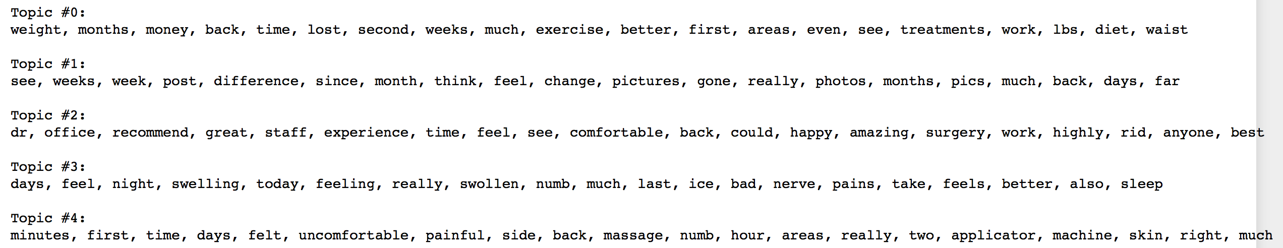
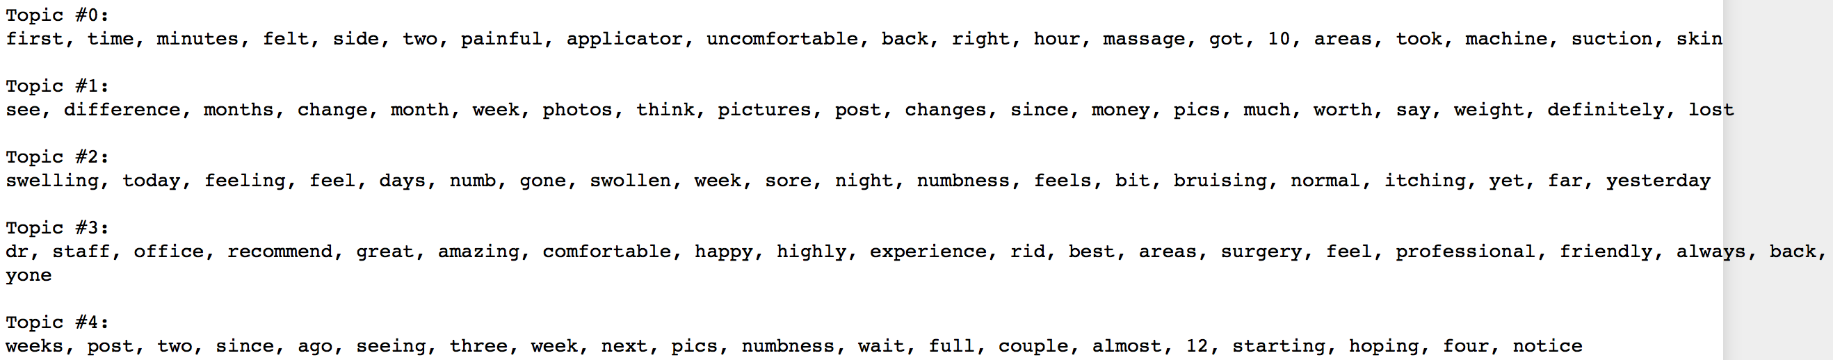
Topic Modeling: Coolsculpting case
LDA TF
max_features = 1000 / max_df = 0.95 / min_df = 2
Results
Photos updates
Doctor/Staff
Recovery/Downtime
Procedure
NMF
max_features = 1000 / max_df = 0.95 / min_df = 2
Procedure
Photos updates
Recovery/Downtime
Doctor/Staff
Recovery/Downtime again ?

Slide 6
% topics on posts evolution (temporary graph)

Slide 7
Sentiment Analysis (TextBlob)
Posts in reviews marked as “worth it”
Posts in reviews marked as “not worth it”
Days after treatment

Slide 8
Sentiment Analysis (TextBlob)
Posts in reviews marked as “worth it”
Posts in reviews marked as “not worth it”

Slide 9
Results Positive Reviews
Sentiment per topic
Topic 0: Results
Topic 1: Photos updates
Topic 2: Doctor/Staff

Slide 10
Results Negative Reviews
Sentiment per topic
Topic 1: Photos updates
Topic 3: Recovery/Downtime

Slide 11
For the Project
Topic modeling for 3 different treatments
Visualization
% Topic evolution
Sentiment evolution on topics
Most frequent words

